Slide 1

職場故事 (Animaze)
Notes:
https://pixabay.com/videos/work-office-people-write-87592/

Slide 2
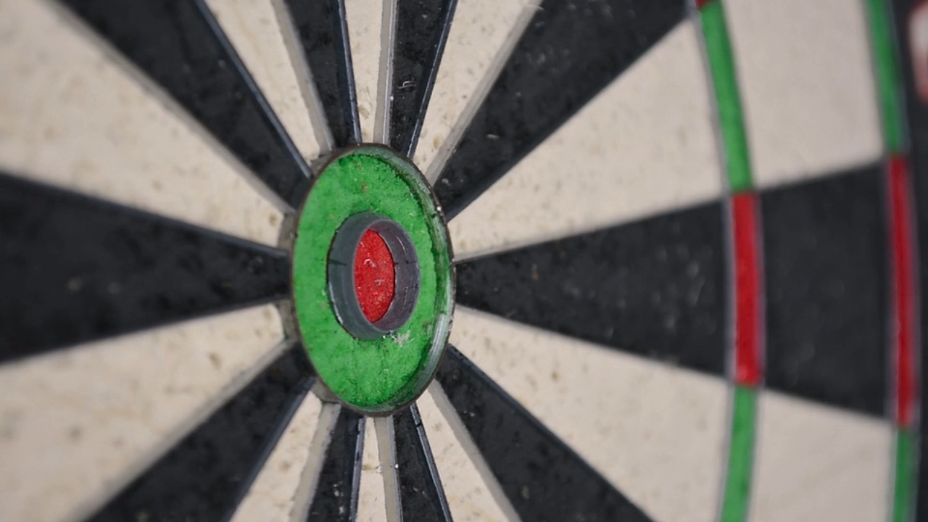
1. 目標
Notes:
https://pixabay.com/videos/darts-board-dart-board-direct-hit-19512/

Slide 3
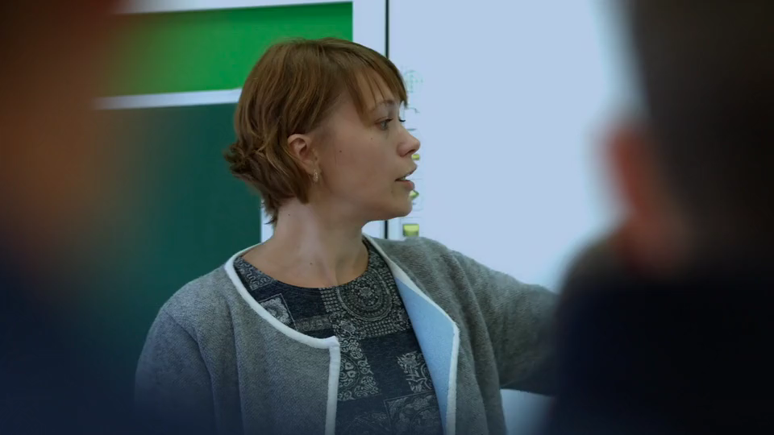
Notes:
https://pixabay.com/videos/lesson-teacher-school-education-106700/

Slide 4

2. 阻礙
Notes:
https://pixabay.com/videos/window-old-wall-20466/

Slide 5
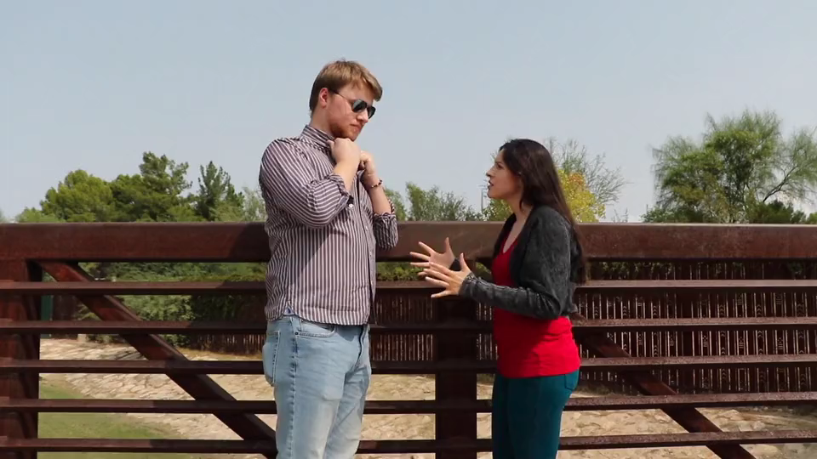
Notes:
https://pixabay.com/videos/couple-arguing-domestic-violence-50311/

Slide 6
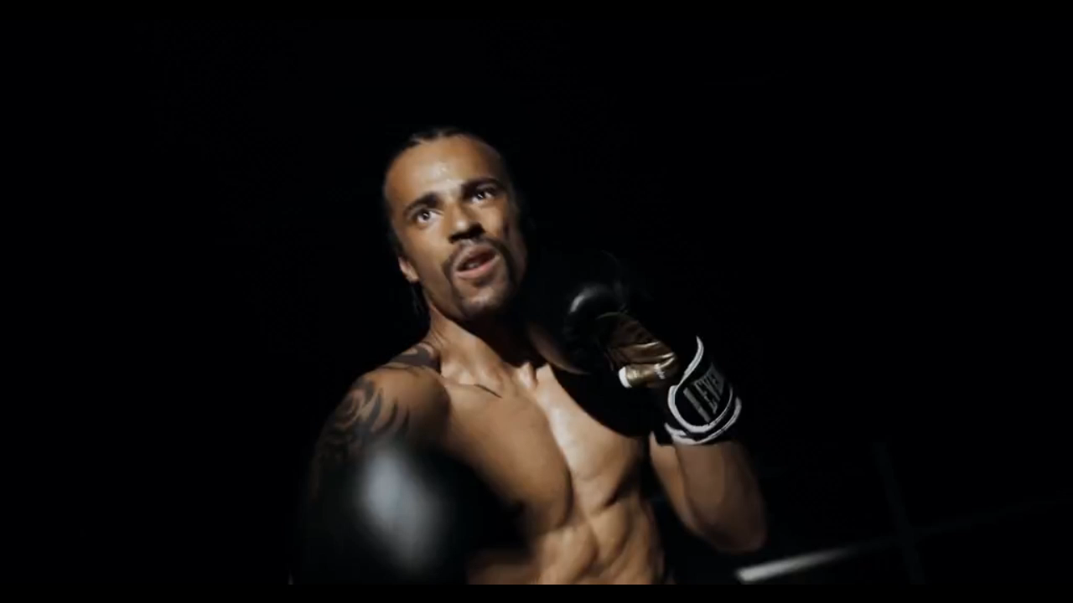
3. 努力
Notes:
https://pixabay.com/videos/man-box-boxer-gloves-sport-216568/

Slide 7
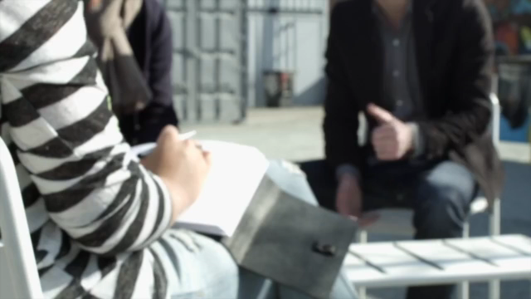
Notes:
https://pixabay.com/videos/talk-discussion-meeting-team-group-1112/

Slide 8

4. 結果
Notes:
https://pixabay.com/videos/title-banner-label-screen-ribbon-105304/

Slide 9
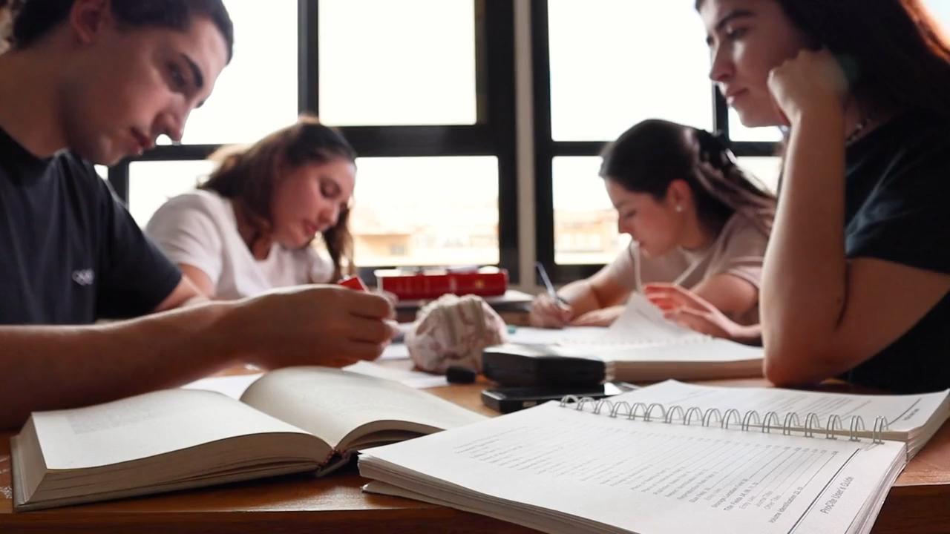
Notes:
https://pixabay.com/videos/students-books-papers-text-study-159029/

Slide 10
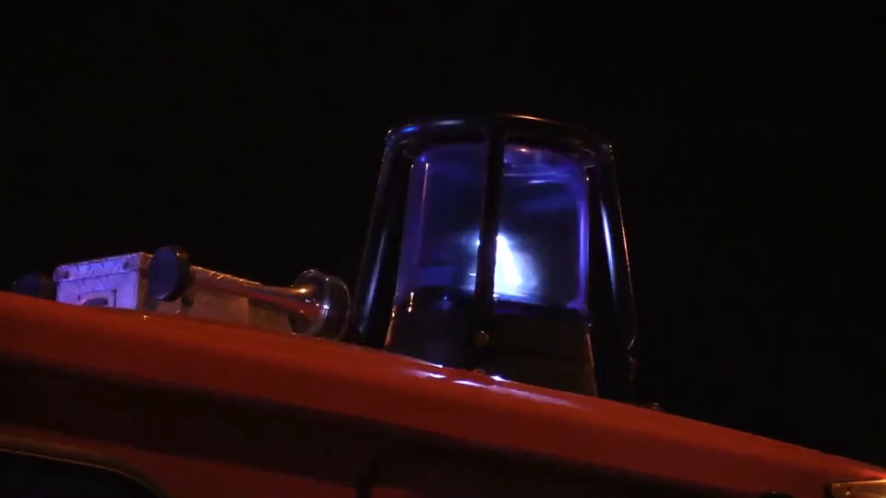
5. 意外
Notes:
https://pixabay.com/videos/blue-light-fire-fighters-mission-7012/

Slide 11
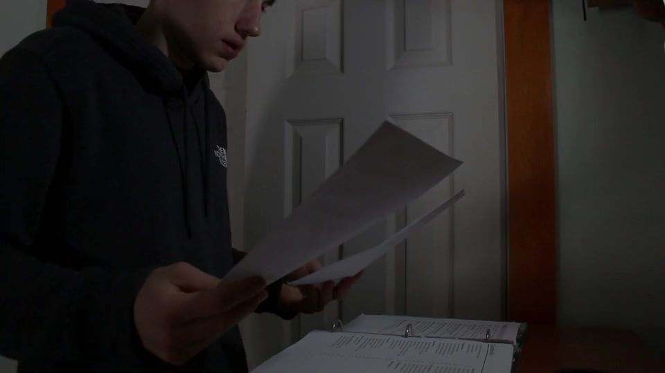
Notes:
https://www.istockphoto.com/en/video/animation-of-colorful-circles-moving-upwards-with-different-icons-on-transparent-gm1214007085-353033905

Slide 12

6. 轉彎
6. 轉彎
Notes:
https://pixabay.com/videos/dice-points-roll-the-dice-to-play-65807/

Slide 13

Notes:
https://pixabay.com/videos/spoons-4k-kitchen-restaurant-19167/

Slide 14
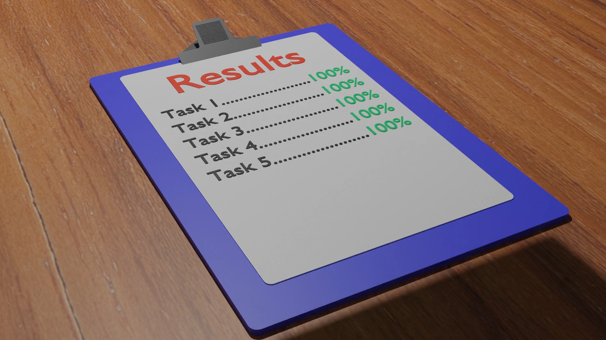
7. 結局
Notes:
https://pixabay.com/videos/rainbow-sky-clouds-blue-background-21460/

Slide 15

Notes:
https://pixabay.com/videos/trophy-award-win-winner-sports-5159/

